Slide 1

CPRG 307 Slides are part of the Instructor Resources for the course required textbook and are provided with permission from the publisher:
Oracle 11g: PL/SQL Programming
Joan Casteel
978-1-133-94736-3
Course Technology (Cengage Learning)
Oracle11g:
PL/SQL Programming
Chapter 2
Basic PL/SQL
Block Structures

Slide 2
PL/SQL Blocks
Anonymous blocks
  Code is not stored in the database.
  A user must execute the entire coding block rather than simply issuing a call statement
  In this course, we will start with the anonymous block and then see how to modularize with the stored programs
Stored Programs
  Procedures, functions, and packages
  Code stored in the database
  Can execute code with a single program call
CPRG 307

Slide 3
PL/SQL Block Structure
DECLARE – create variables, cursors, and types
BEGIN – SQL, logic, loops, assignment statements
EXCEPTION – error handling
END – close the block
Oracle11g: PL/SQL Programming

Slide 4
Variable Names
Begin with alpha character
Up to 30 characters
Can contain upper and lowercase letters, numbers, _ , $ , #
No spaces
Variable names should be descriptive
Oracle11g: PL/SQL Programming

Slide 5
Scalar Variable Data Types
Character – CHAR(n)
VARCHAR2(n)
Numeric – NUMBER(p,s)
Date – DATE
Boolean – BOOLEAN
Note: Only holds a single value
Oracle11g: PL/SQL Programming

Slide 6
Example Scalar Declarations
DECLARE
lv_ord_date DATE;
lv_last_txt VARCHAR2(25);
lv_qty_num NUMBER(2);
lv_shipflag_bln BOOLEAN;
BEGIN
---- PL/SQL executable statements ----
END;
Note: Minimum requirements are variable name and data type
SET SERVEROUTPUT ON when using dbms_output.put_line.
Oracle11g: PL/SQL Programming

Slide 7
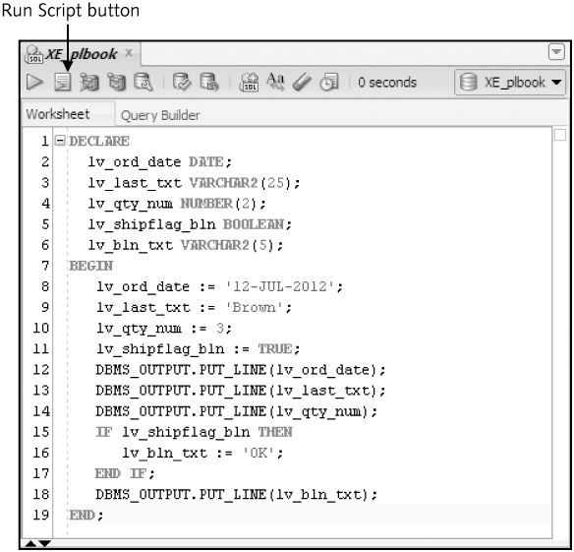
Test Variables
Oracle11g: PL/SQL Programming

Slide 8
Variable Initialization
Set a variable value when the variable
is created
DECLARE
lv_ord_date DATE := SYSDATE;
lv_last_txt VARCHAR2(25) := 'Unknown';
lv_qty_num NUMBER(2) := 0;
lv_shipflag_bln BOOLEAN := FALSE;
BEGIN
---- PL/SQL executable statements ----
END;
Oracle11g: PL/SQL Programming

Slide 9
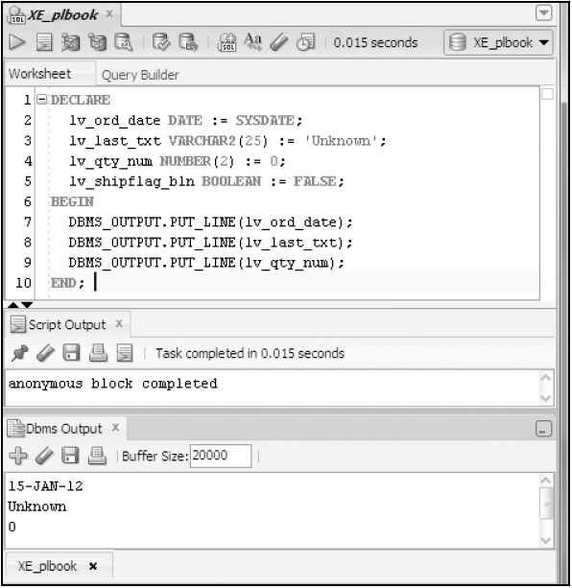
Test Variable Initialization
Oracle11g: PL/SQL Programming

Slide 10
Variable Declaration Options
NOT NULL – the variable must always contain a value
CONSTANT – the variable value can not be changed in the block
DECLARE
lv_shipcntry_txt VARCHAR2(15) NOT NULL := 'US';
lv_taxrate_num CONSTANT NUMBER(2,2) := .06;
BEGIN
---- PL/SQL executable statements ----
END;
Oracle11g: PL/SQL Programming

Slide 11
Calculations with Scalar Variables
multiplication
DECLARE
lv_taxrate_num CONSTANT NUMBER(2,2) := .06;
lv_total_num NUMBER(6,2) := 50;
lv_taxamt_num NUMBER(4,2);
BEGIN
lv_taxamt_num := lv_total_num * lv_taxrate_num;
DBMS_OUTPUT.PUT_LINE(lv_taxamt_num);
END;
/
Oracle11g: PL/SQL Programming

Slide 12
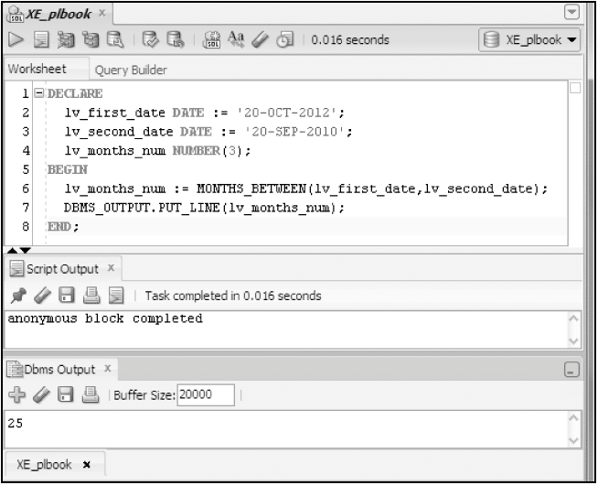
Using SQL Functions
SQL functions such as MONTHS_BETWEEN can be used
within PL/SQL statements
Oracle11g: PL/SQL Programming

